Slide 1


PRESENTATION ON: UNUSED MEDICINE DONATION SYSTEM
PRESENTED BY : GUIDED BY :
Aryan Shingan Dr. R.V.Babar
Sushant Kokate
Shreyash Ramteke
Akash Chavan
Department of Information Technology.
STES’s
Sinhgad Institute of Technology, Lonavala

Slide 2
Agenda
1. Introduction
2. Motivation
3. Literature Survey
4. Problem Statement
5. Mathematical model (Input output parameter, Expected outcome, success and Failure cases of the system)
6. System Architecture / Methodology
7. Modules
8. Proposed Algorithm
9. UML Diagrams

Slide 3
Agenda
10. Applications
11. Timeline chart
12. Conclusion and future scope
13. References

Slide 4
Introduction
Addressing unused medicines and affordable healthcare.
We're connecting extra medicines with people who really need them but can't afford them.
Four key roles: admin, NGO, user, and doctors.
Admin manages users, removes those with incorrect/expired drugs.
Admin has a consultant, like the NGO's request.

Slide 5
Motivation
In India, many very poor struggle to afford medicine and healthcare.
As a result, they suffer from diseases, leading to daily increases in the number of deaths.
But some people take too many medicines when they're not supposed to.
Here, we have set up a website for donating medicines to NGO’s.
We built a website to collect and provide unused medicines to low-income people.
.

Slide 6
Existing System vs Our Project
The authorized verification
The sell option

Slide 7
Literature Survey
Name of the paper | Author Name | Advantages | Disadvantages | Publisher | Year
A Webportal for Medicine Distribution among Poverty-stricken People | Chowdhury Nawrin Ferdous | Many needy people will get cured. | Does not have authorized verification of medicine. | 7 IEEE Region 10 Humanitarian Technology Conference | 2020
Online Medicine Donation System | Nitesh A. Godhichor | It will help to maintain records of medicines. | User does not get the doctor’s approval. | International Journal of Creative Research Thoughts (IJCRT) | 2021

Slide 8
Literature Survey
Name of the Paper | Author Name | Advantages | Disadvantages | Publisher | Year
A Web Portal for Medicine Donation to NGO’s and Check availability of Medicine in NGO’s | Shivam Ramanvar | It helps poor people for medication. | Does not have the option to sell the medicines. | International Journal of Research in Engineering. | 2021
Online Medicine Donation Portal | Sanket Rajendrakumar More | It will make medicines available at the right time for the NGO and people. | User needs to put correct data or else it behaves abnormally. | International Journal of Advance Research, Ideas and Innovations in Technology . | 2021

Slide 9
Problem Statement
To build and implement unused medicine donation system.

Slide 10
Mathematical Model
Let us consider S as a system.
S=
INPUT:
Identify the inputs-Tell unused medicines and their expiry date
F= f1, f2, f3 ....., FN— F as set of functions to execute commands.
I= i1, i2, i3—I sets of inputs to the function set
O= o1, o2, o3.—O Set of outputs from the function sets,
S= I, F, O
I = Input
O = Output
F = Functions implemented to get the output
Output-Suggest the proper medicine

Slide 11
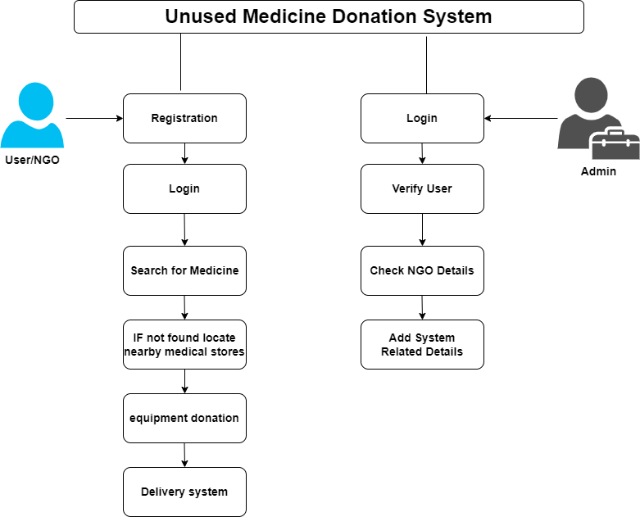
Architecture

Slide 12
Project Modules
-Registration/Login
-Search form free medicine
-Recommend nearby Locations
Delivery system
-if medicine not found locate nearby medical stores

Slide 13
Proposed System
Medications are a fundamental component in lightening enduring, and gifts of clinical supplies will incredibly profit worldwide helpful aid projects.
This excess medication can be utilized by NGOs, Hospitals who are to be sure for those prescriptions.
By the utilization of this entry, there will be less wastage of drugs.

Slide 14
Use Case Diagram

Slide 15
Class Diagram

Slide 16
Tools Used :
Hardware Requirements :
Processor - Intel i3/i5/i7
Speed - 3.1 GHz
RAM - 4 GB(min)
Hard Disk - 40 GB
Keyboard - Standard Windows Keyboard
Mouse - Two or Three Button Mouse
Monitor - SVGA

Slide 17
Tools Used
Software Requirements :
Operating System - Windows 7/8/10
Front End - HTML, CSS, Bootstrap
Database - MySQL
IDE - VS Code
Language - Python

Slide 18
Application
This project or this online medicine donation portal in the future has the ability to become a full fledge application wherein all the facilities will be provided on this portal.

Slide 19
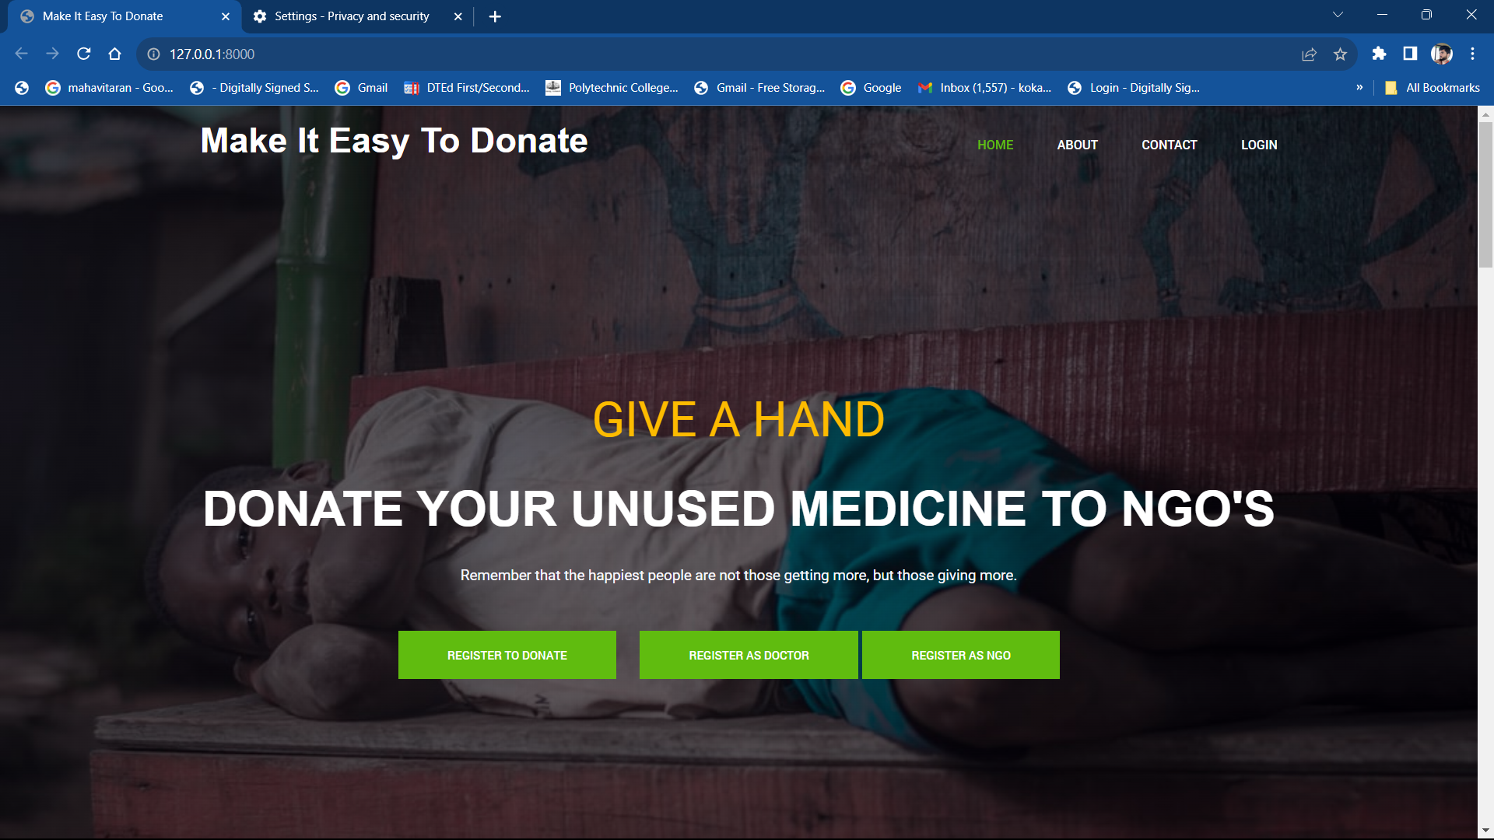
Expected Result
Fig. Home Page

Slide 20
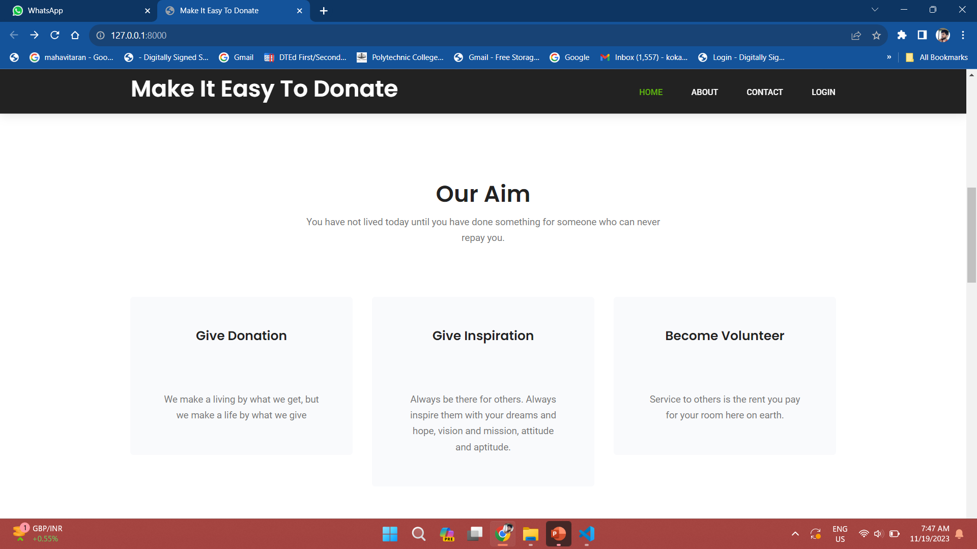
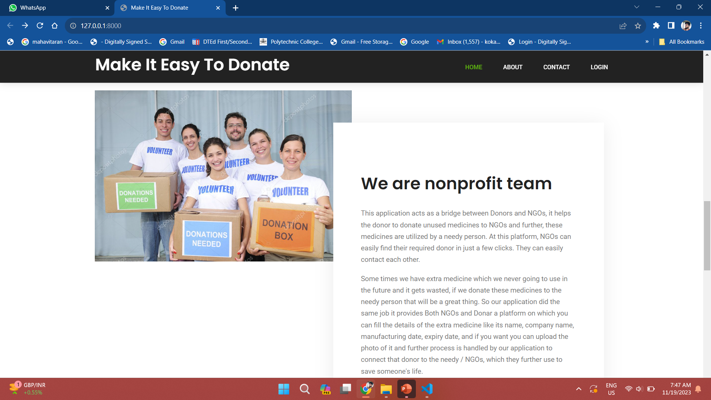
Expected Result
Fig. Home Page

Slide 21
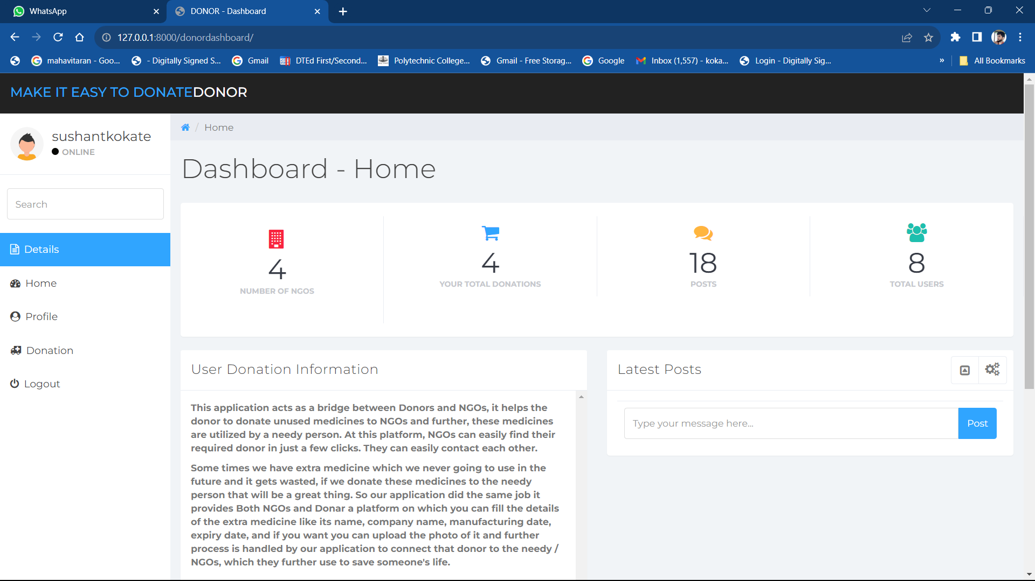
Expected Result

Slide 22
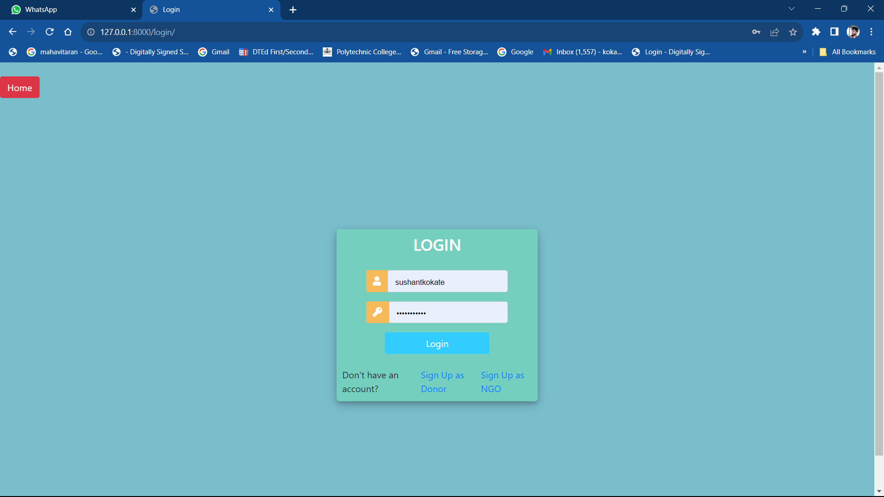
Expected Result

Slide 23
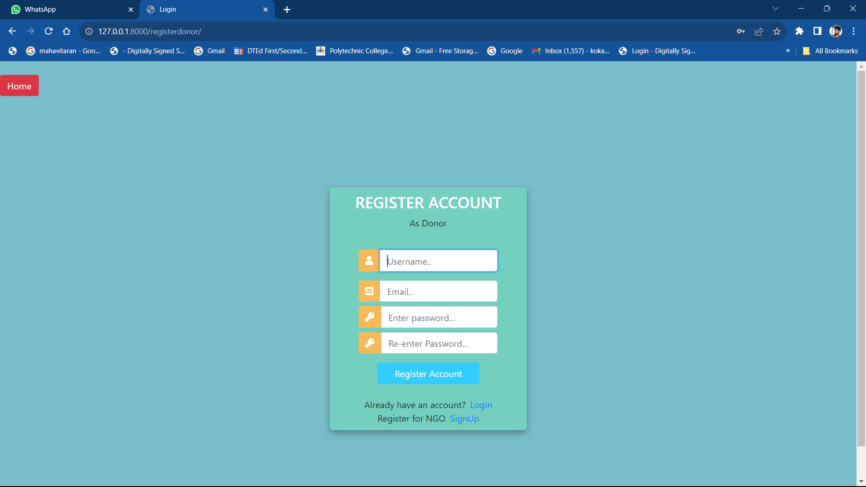
Expected Result

Slide 24

Expected Result

Slide 25
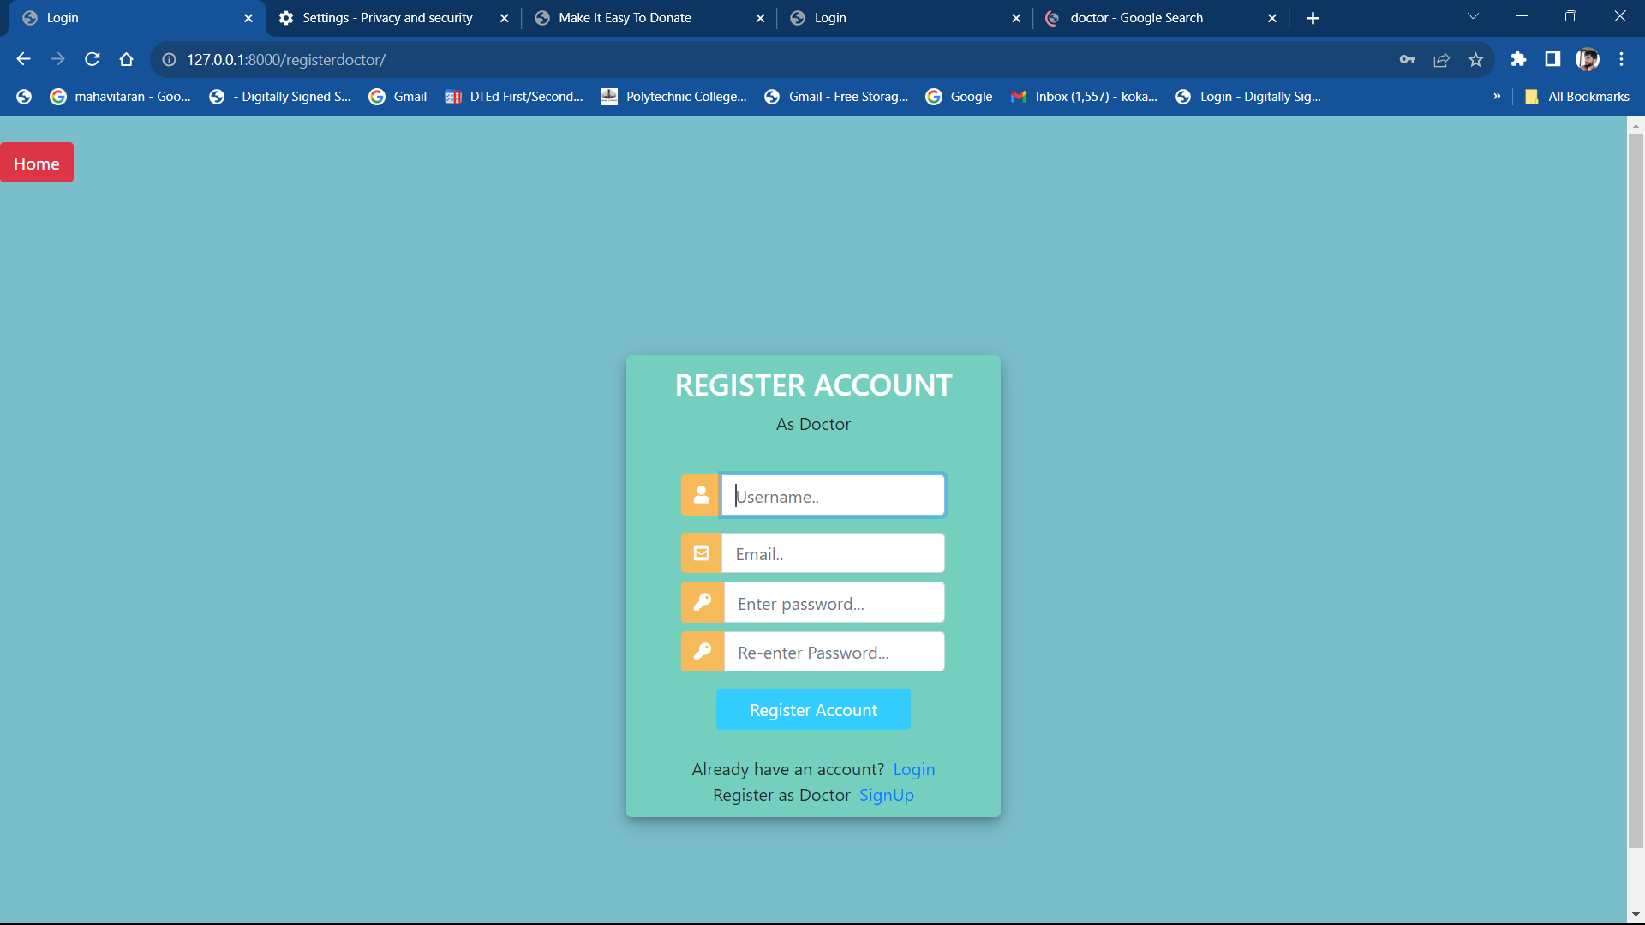
Expected Result

Slide 26
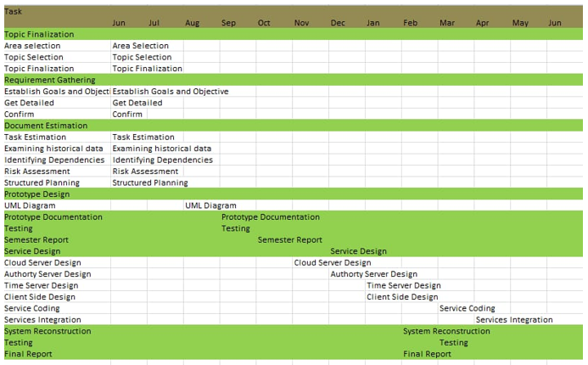
Timeline Chart

Slide 27
Conclusion
Our portal aim to provide unused medicine to NGO and hospitals.
Our portal is aimed at being available for users , with the latest features added at the moment.
By having an easy navigation system for users, the portal will become friendly, which will also make the users comfortable for donating and receiving medicines from NGO’s.

Slide 28
References
UNUSED MEDICINE DONATION PLATFORM Ms. Rutuja Satish Vathare*1, Ms. Rupali Rajesh Koravi*2,Ms. Vaishnavi Vijaykumar Sanade*3, Mr. Ketan Ramesh Patil*4, Ms. S. B. Ketkale*5*1,2,3,4,5Compute Department, D.K.T.E. Society’s Yashwantrao Chavan Polytechnic, Icalkaranji, India.Volume:05/Issue:04/April-2023
An Online Unused Medicine Donation System for NGOsHarendra Raghav1, Ayush Singh Chauhan2, Tanya Yadav3,Ankit Kumar Gupta4,Ankur Bhardwaj5 International Journal of Engineering and Techniques - Volume 8 Issue 3, May 2022

Slide 29
References
An Online Web Portal for Donating Unused Medicine to NGOs Conference Paper · June 2022author profiles for this publication at: https://www.researchgate.net/publication/361389050
Unused Medicine Donation System for NGOsProf. Sunil Sangale1, Rahil Khan2, Spandan Marathe3, Pratik Yeole4, Kaveri Khairnar5 Lecturer, Department of Computer Technology1Students, Department of Computer Technology2,3,4,5K. K. Wagh Polytechic, Nashik, Maharashtra, India Volume 2, Issue 2, February 2022

Slide 30
References
"Online Medicine Donation System", International Journal of Emerging Technologies and Innovative Research (www.jetir.org), ISSN:2349-5162, Vol.8, Issue 5, page no.e306-e308, May-2021, Available :http://www.jetir.org/papers/JETIR2105580.pdf
Online Medicine Donation Portal, International Journal of Advance Research, Ideas and Innovations in Technology,Sanket Rajendrakumar More,2021

Slide 31
References
A Web Portal for Medicine Donation to NGO’s and Check availability of Medicine in NGO’s. International Journal of Research in Engineering. Shivam Ramanvar,2021
Online Medicine Donation System, International Journal of Creative Research Thoughts (IJCRT), Nitesh A.Godhichor,2021
A Webportal for Medicine Distribution among Poverty-stricken People, 7 IEEE Region 10 Humanitarian Technology Conference,Chowdary Narwin Ferdous,2020

Slide 32
References
Worldometers.info, Bangladesh Population (2017)-Worldometers, 2017 (accessed June 22, 2017). [Online].Available: http: //www.worldometers.info/world-population/bangladesh-population/ .
Who.int, WHO—Bangladesh, 2017 (accessed June 22, 2017). [Online].Available:http://www.who.int/workforcealliance/countries/bgd/en/ .
Opinion.bdnews24.com, Health Workforce in Bangladesh, 2013 (accessed June 22, 2017).

Slide 33
References
[Online]. Available: http://http: //opinion.bdnews24.com/2013/03/24/health-workforce-in-bangladesh/ .
WHO Guidelines for Medicine Donations. 3rd ed. 2011. http://whqlibdoc.who.int/publications/2011/9789241501989 _eng.pdf. Accessed 2014 Dec .
Dory J. Donation of medical device technologies. In: Dior J, ed. Clinical engineering handbook. Burlington, ElsevierAcademic Press, 2004:155– 158.

Slide 34
THANK YOU

